Slide 1


Hand Gesture Detection for Speech-impaired Peoples

Slide 2


Today’s Agenda
Project Recap
Problem Statement
Process
Data Collection
Data Preprocessing
Data Modeling
Model Evaluation
Real Time Implementation
Risk and Challenges
Conclusion

Slide 3


This project aims to develop a system that enables speech-impaired peoples to communicate effectively by recognizing and translating hand gestures into spoken language.
By leveraging advanced computer vision techniques, this system will empower peoples with speech disabilities to express themselves more freely in social and professional interactions.
Project Recap

Slide 4


Problem Statement
Speech impairment poses significant challenges for peoples in expressing their thoughts and needs, impacting their ability to communicate effectively in both personal and professional contexts

Slide 5

Process
1
Data Collection
2
Data Preprocessing
3
Data Modelling
4
Model Evaluation
5
Realtime Implementation

Slide 6


Insights
10
15000
10000
5000
Unique Classes
Total Images
Training Images
Testing Images

Slide 7
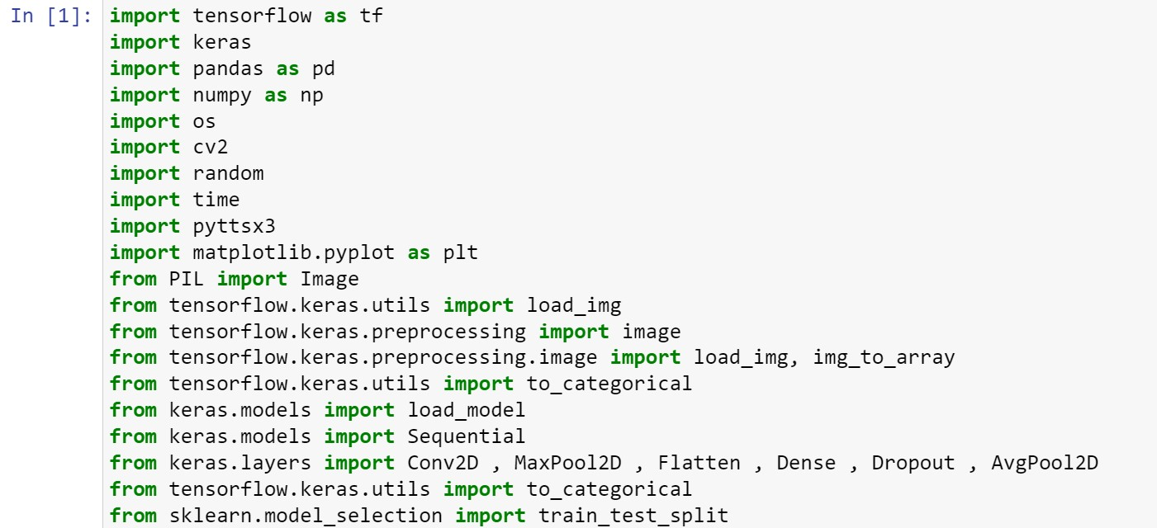
Libraries Used :-

Slide 8
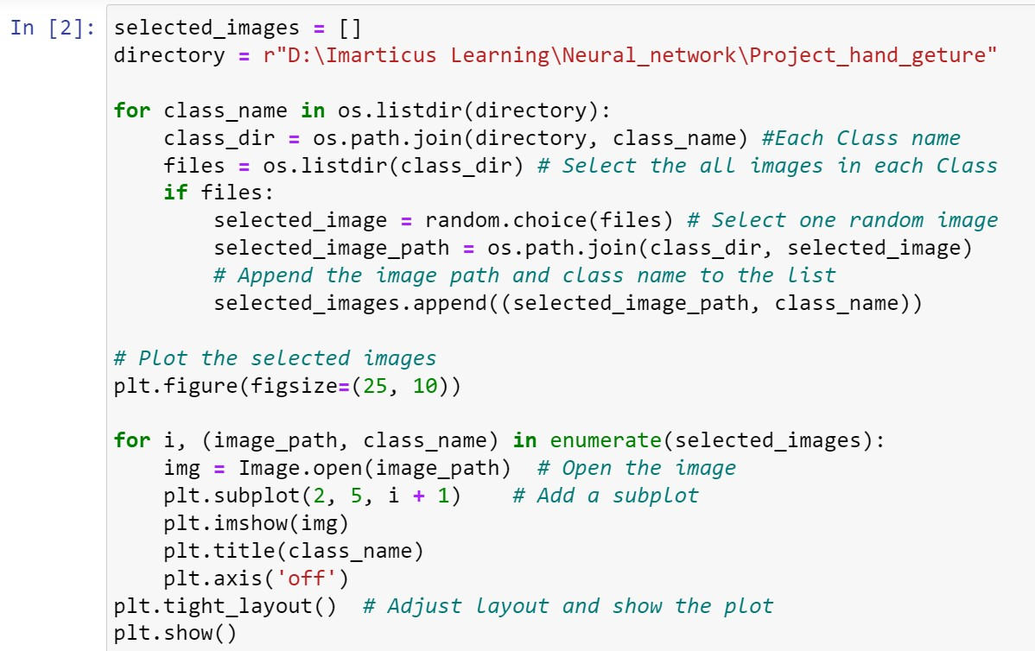
Data Collection :-
Importing Images:

Slide 9
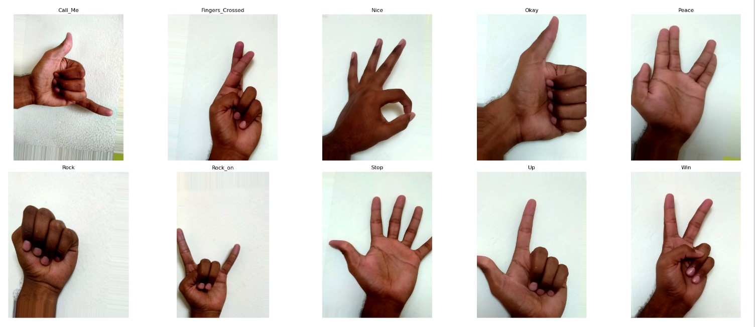
There are a total of 10 distinct classes , Randomly select the one image from each class .

Slide 10
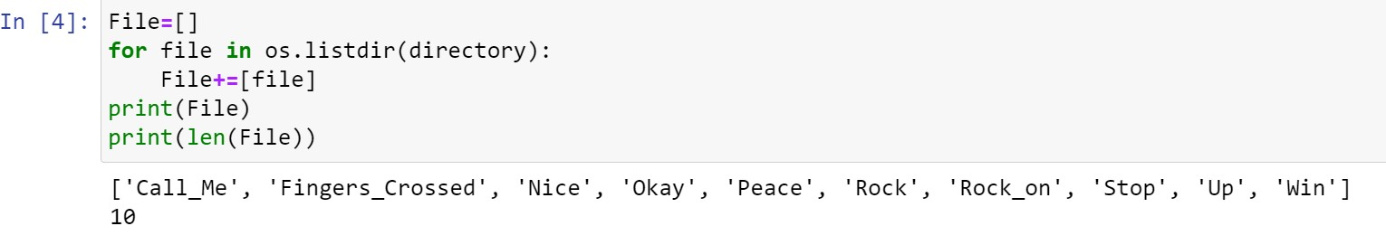
Data Pre-processing :-
There are a total of 10 distinct classes.
Select All images from each class and convert into array
After , Normalized the array images (improve the efficiency of model)
Then split into Training and Testing Dataset with output

Slide 11
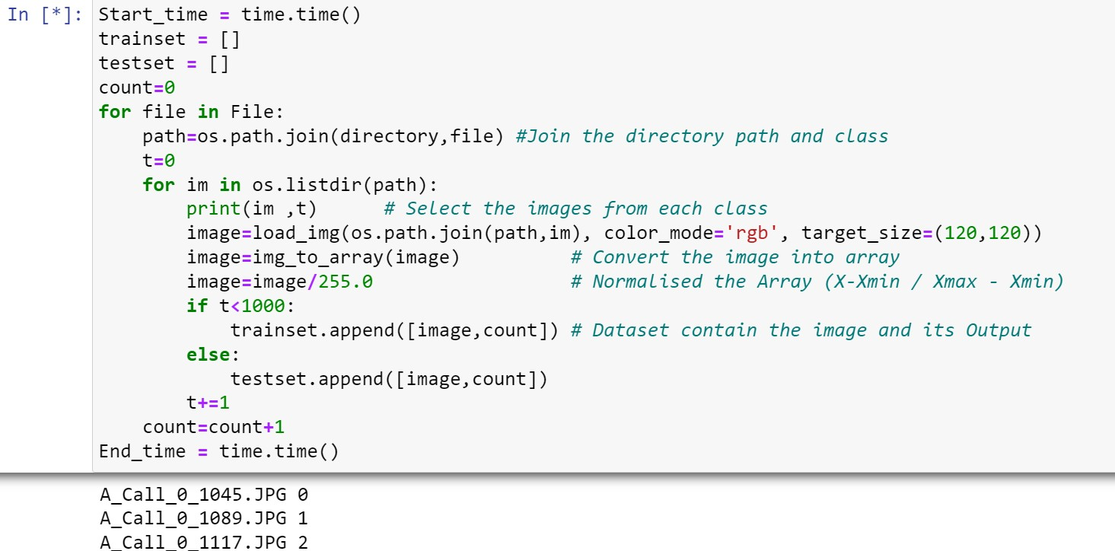

Slide 12
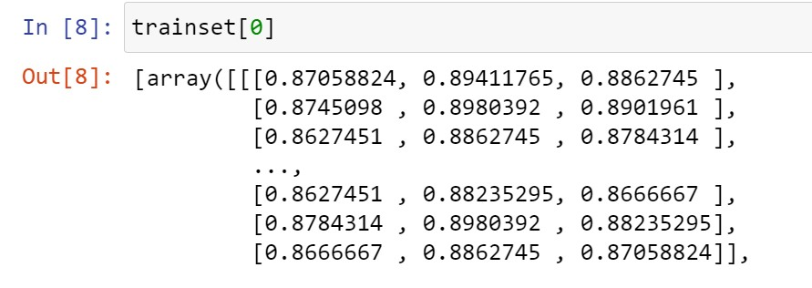
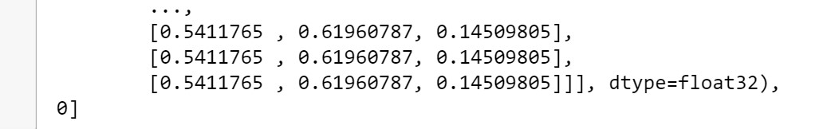
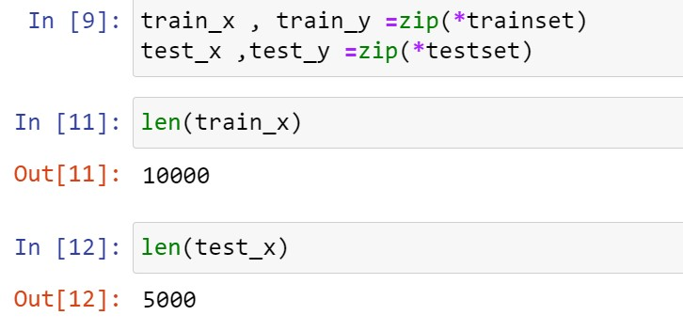
Train – Test Split:

Slide 13
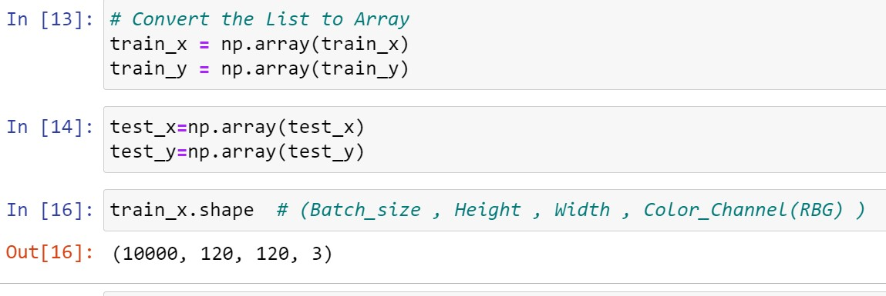
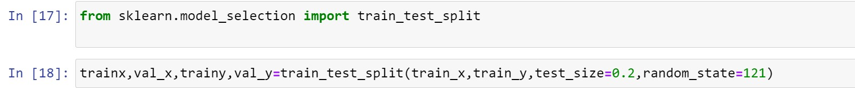
Convert List to Array:
Train – Validation Split:

Slide 14

Data Modelling :-
Convolutional Layer :-
This Layer is extract the features from I/P images
Here , Filter is slided over the image and computing the dot product
N – K + 1 = O/P (N= input size , k = slider size
Pooling Layer :-
Reduce the Dimensionality of each feature map but retain the most important feature
Convolutional output is the input for the pooling

Slide 15
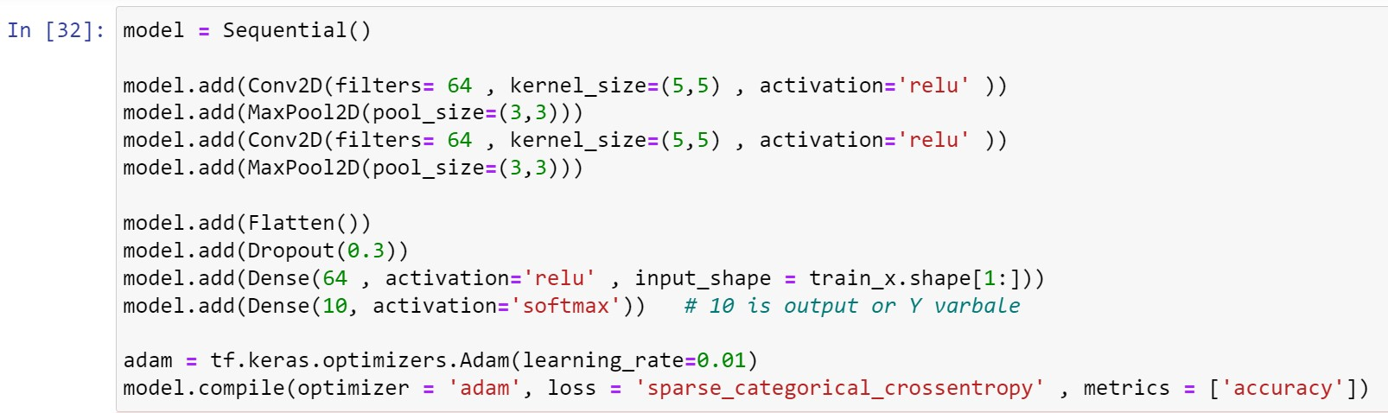
Fully Connected Layer :-
Each Layer of previous layer is connected to all other neurons of next layer is known as dense layer
Each neurons in the hidden layer it having its own RELU

Slide 16
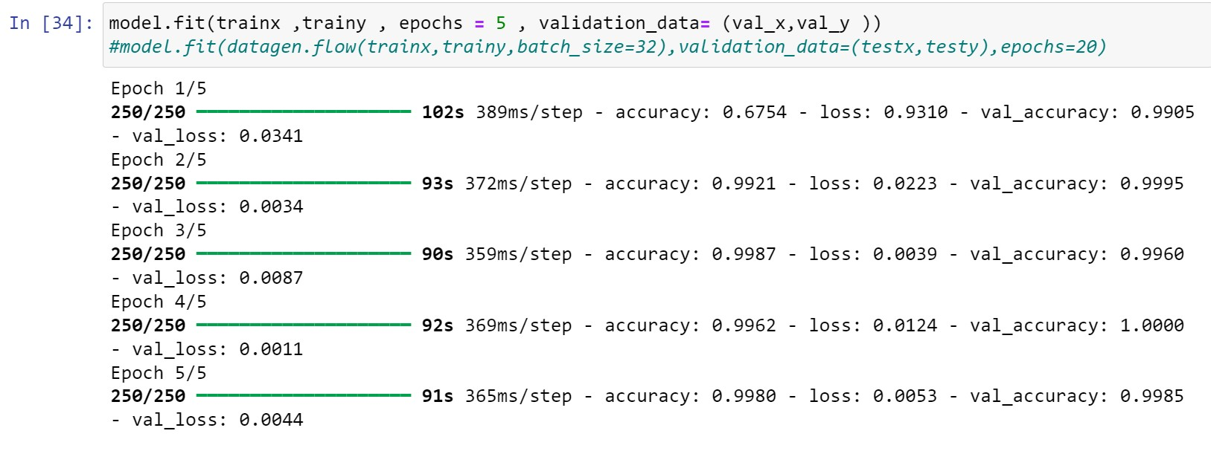
Train The Model
Model is train it gives the 99.80 % Accuracy on Train Data
And its gives the 99.85 % Accuracy on Validation Data

Slide 17
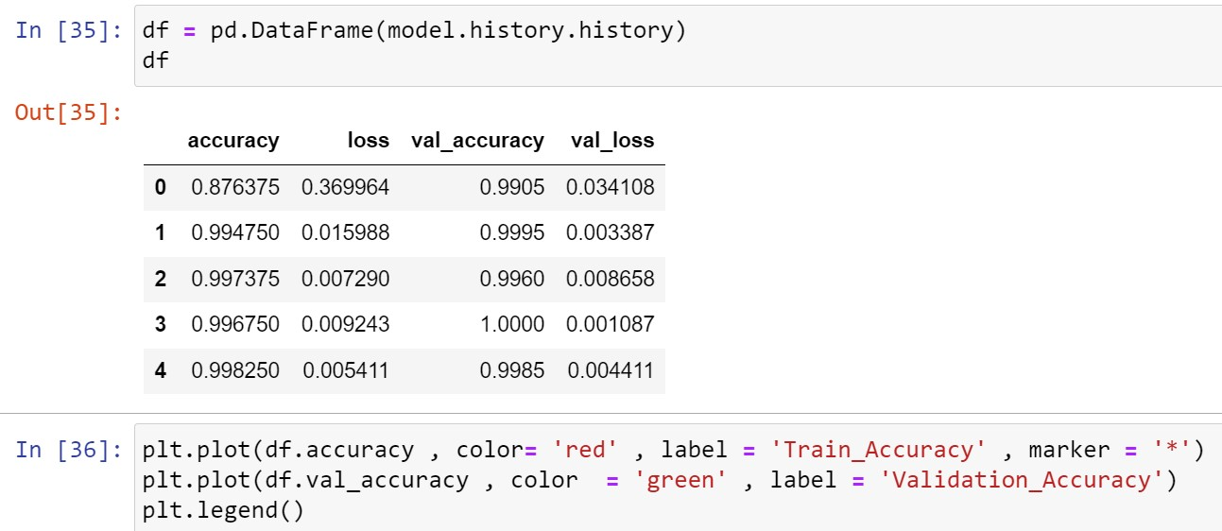
Model Evaluation :-
Accuracy and Loss Graph:

Slide 18
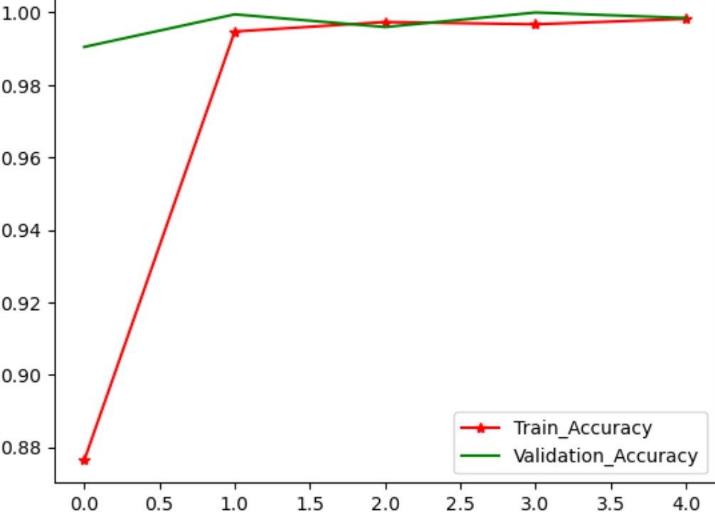
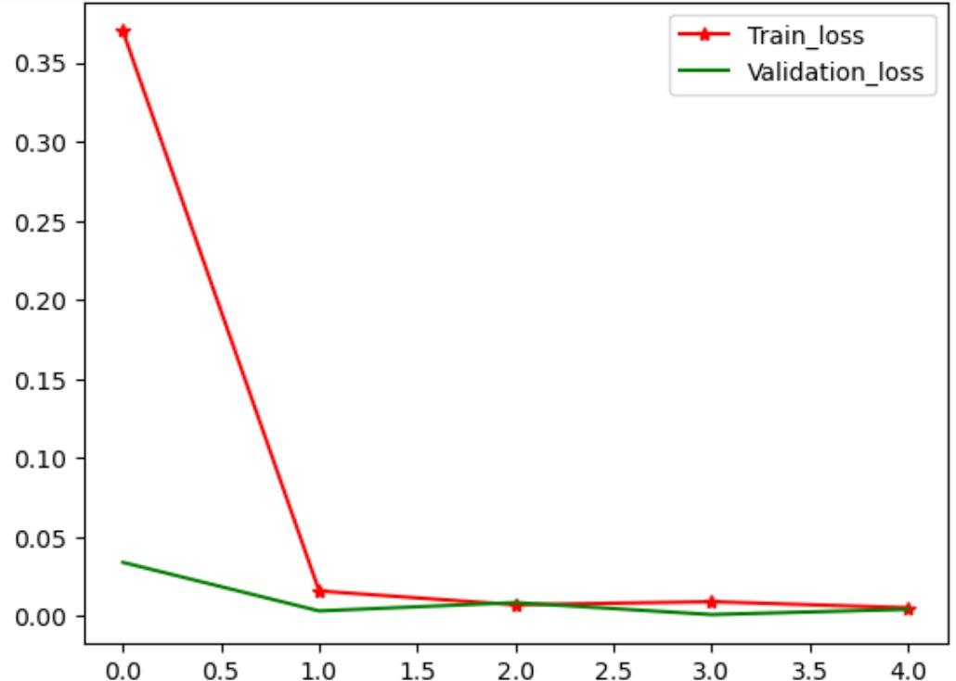
Accuracy Graph:
Loss Graph:

Slide 19
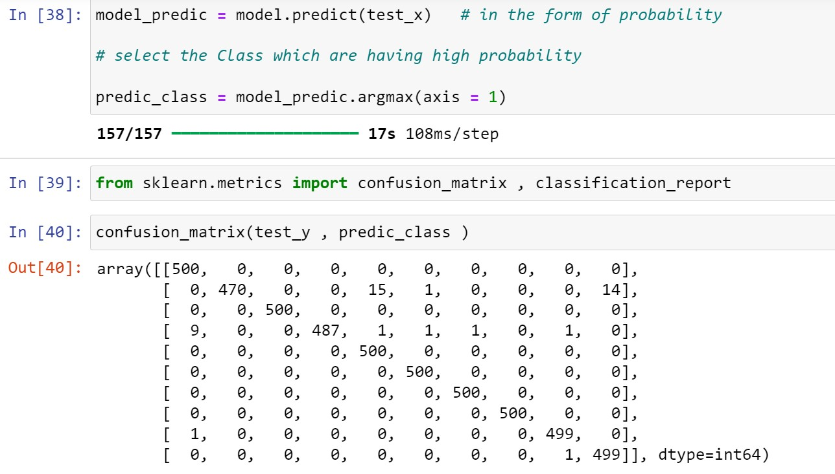
Prediction On Test :

Slide 20
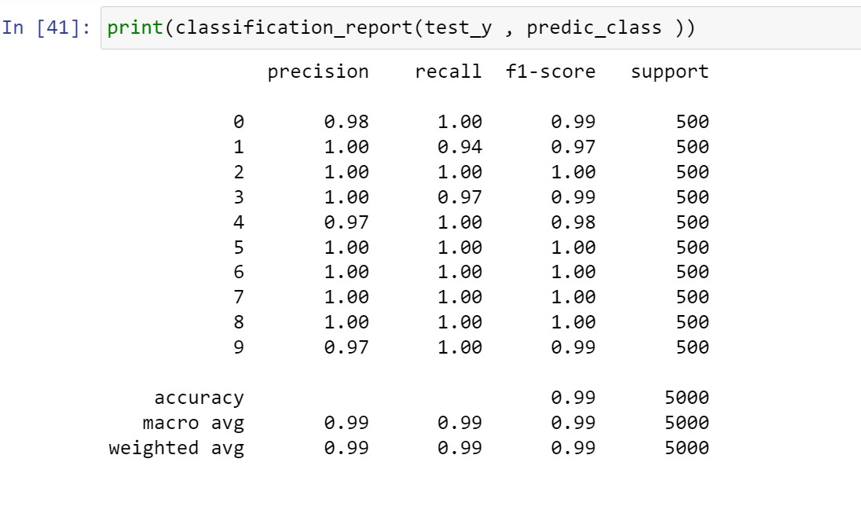
Conclusion :
Model is test it gives the 99 % Accuracy on Test Data
The model has achieved an impressive accuracy of 99.80 % on training and 99 % on test datasets, indicating excellent performance and generalization.
The consistency between training and test accuracy indicates that the model is not over fitting and has learned the underlying patterns well.

Slide 21
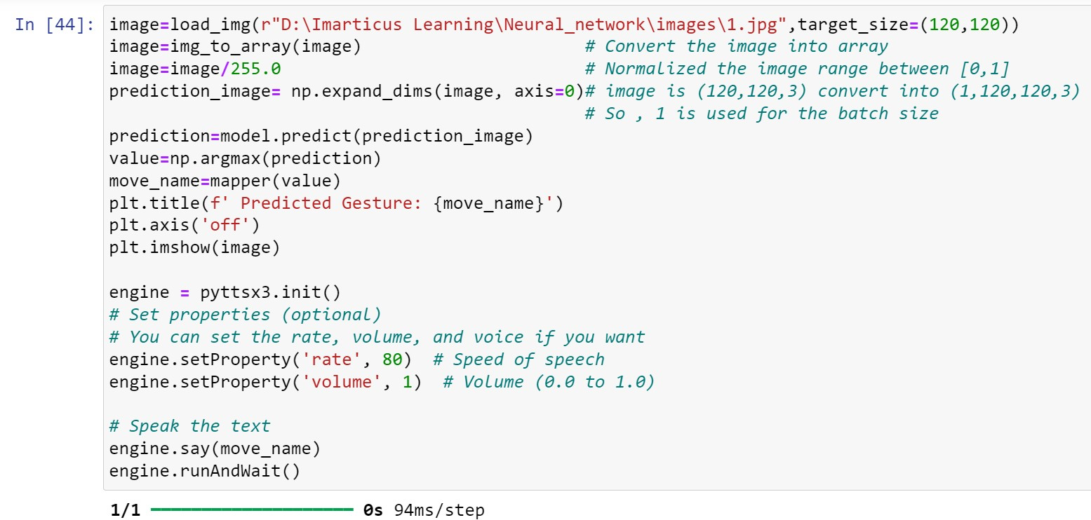
Real–Time Implementation :-
Prediction On New Image :

Slide 22
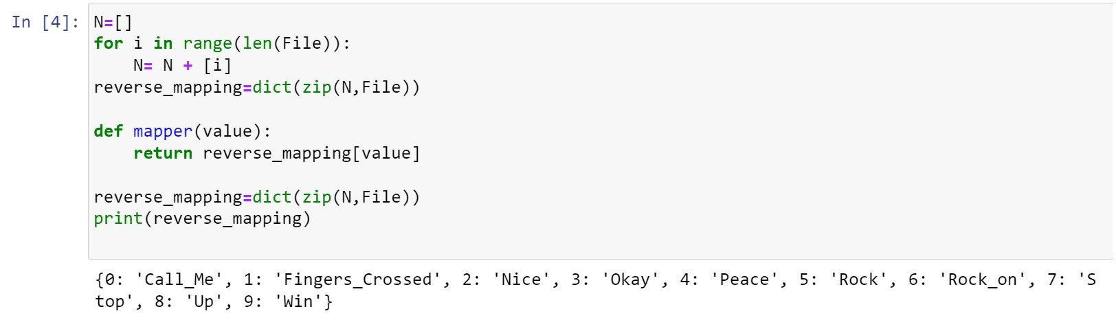
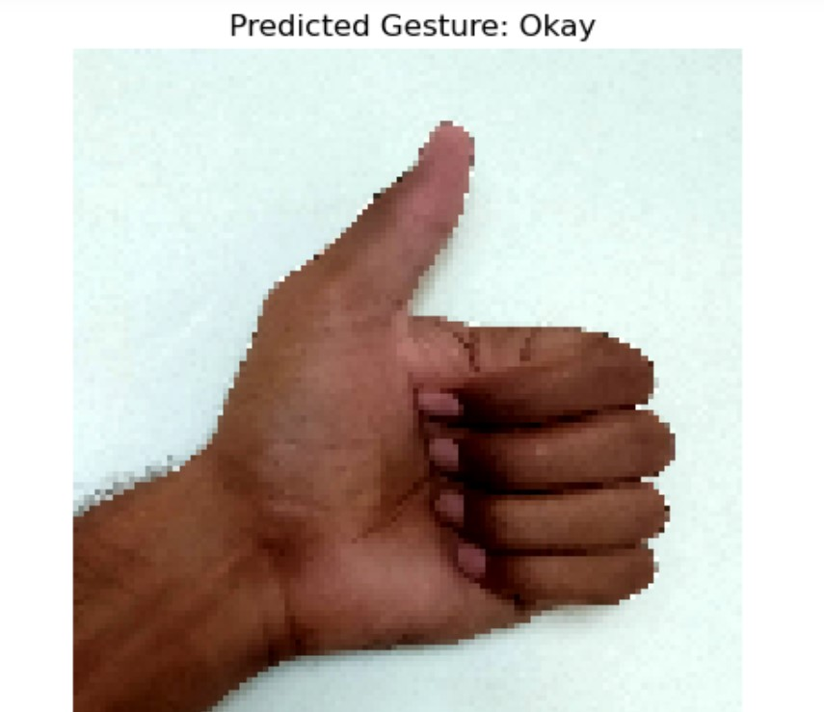
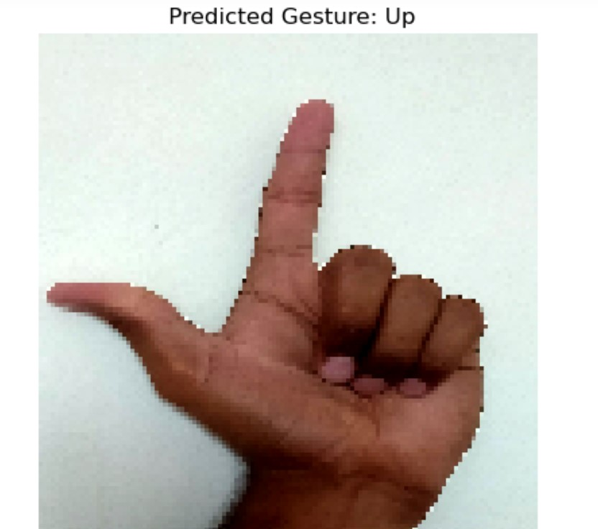
The hand gesture recognition model has proven to be highly accurate, reliable, and effective in recognizing hand gestures across different datasets, including new images.
This performance confirms the model’s robustness and practical applicability.

Slide 23
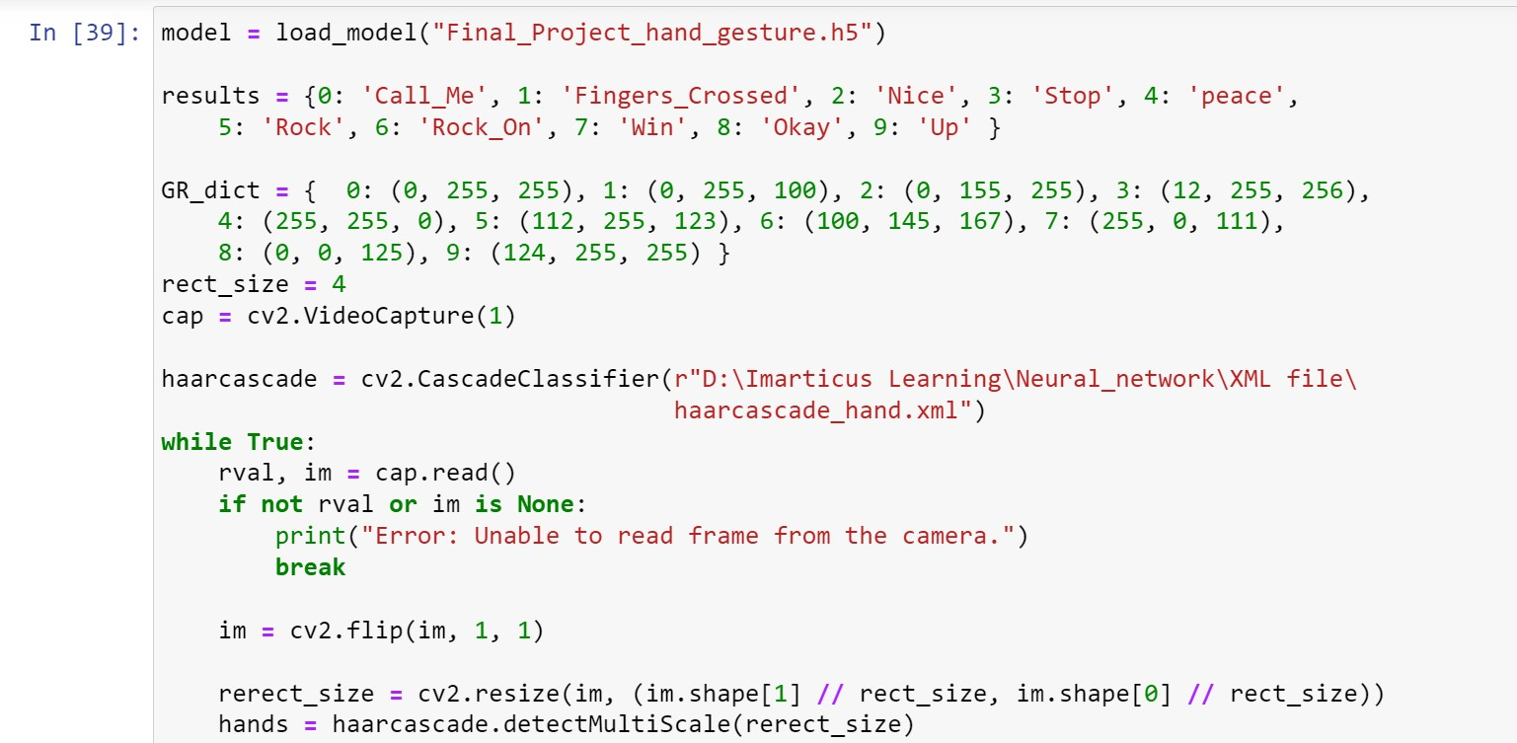
Real Time Capture Image :

Slide 24
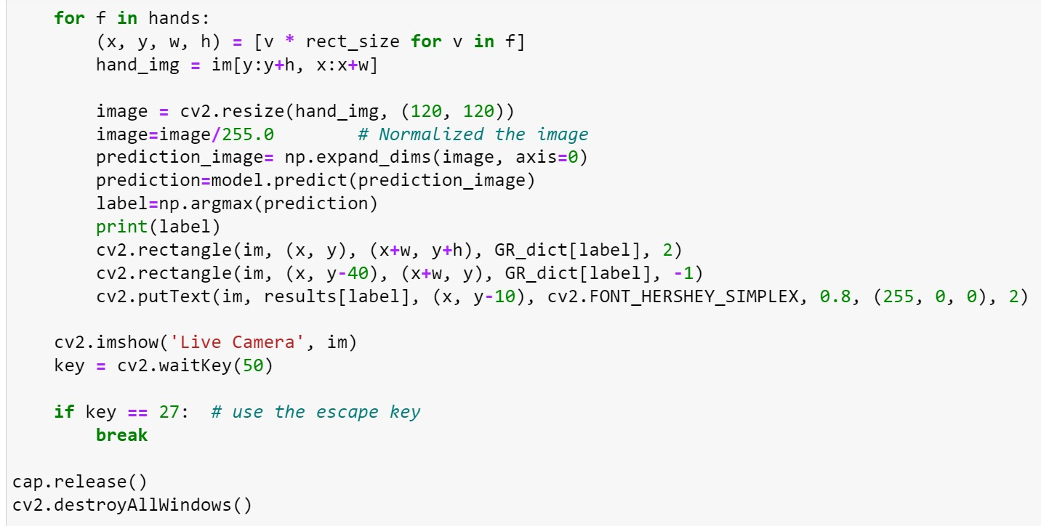

Slide 25
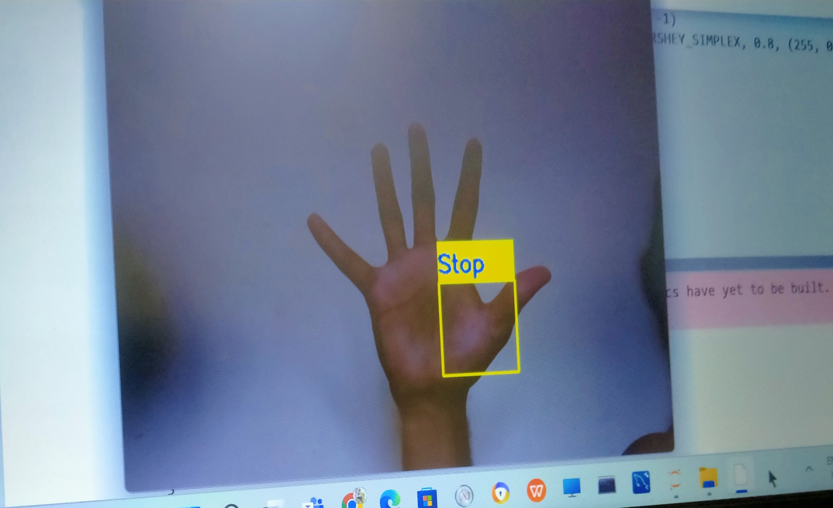

Slide 26
Risk and Challenges :-
CNN model is Hungry Model , Its Required lots of images . To overcome this problem used the Image Generator.
Variations in lighting can affect the accuracy of hand detection and gesture recognition.
Capturing images for gesture recognition can raise privacy and security concerns.
The model might not perform in real-time due to computational limitations, leading to lag or delayed predictions.
Images Loading takes 74 min and Model building consuming a lot of time

Slide 27
Conclusion :-
The "Hand Gesture Detection for Speech-Impaired Peoples“ project aiming to improve the quality of life and communication abilities of speech-impaired individuals.
This project promises in improving the quality of life and communication abilities of speech impaired individuals. This Peoples expressed themselves more confidently and participate fully in social and professional interactions.

Slide 28

Thank you!
ANY QUESTIONS?

